Slide 1

Summer Training Project : Programming Pathshala DSA
Ritesh Singh
12102719

Slide 2
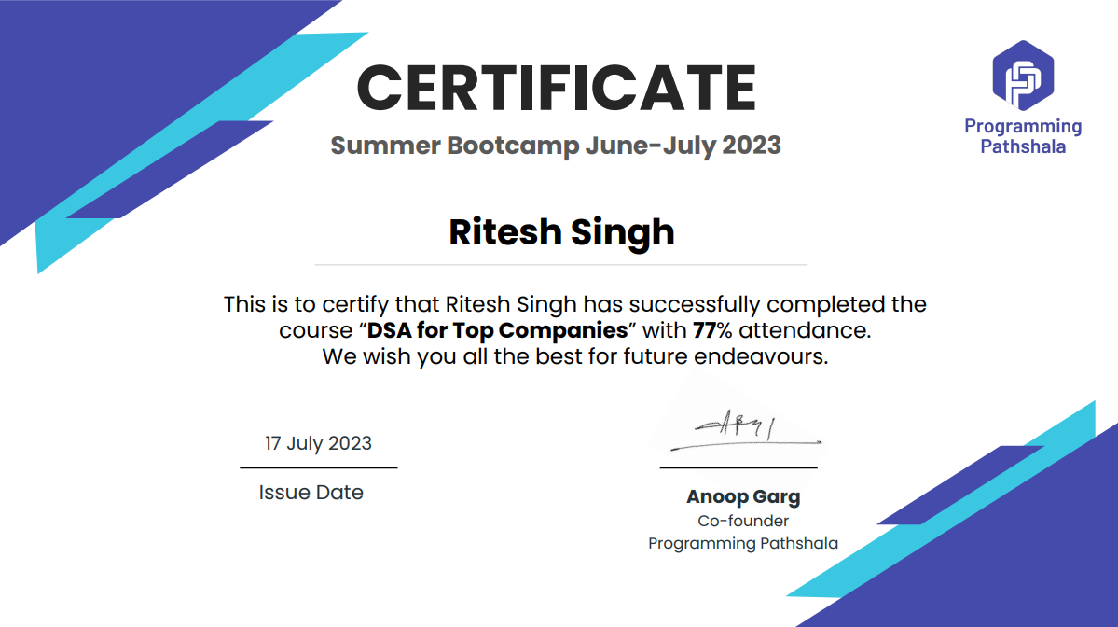

Slide 3
Core Topics Learnt 1. Arrays 2. Searching Algorithms 3. Sorting Algorithms 4. Recursion 5. Hashing 6. String Manipulation 7. Linked List 8. Tree

Slide 4
Slides in Brief
1
2
3
4
5
Introduction
Code-Snippets
Code - Explanation
Scope
Conclusion

Slide 5
Project: Parking Management System The Project is made in Java Language and uses data structures such as HashMap, queue, array list with implementation of string manipulation. The reason for choosing java is because of it’s modularity and abundance of predefined methods

Slide 6

Introduction
This project is made with the learnings done in the summer training program provided by Programming
Pathshala. The program was “DSA for Top Companies”.
The project i.e parking management system, implements concepts learned in the program, some of which can be found in methods implemented as shown in next slides.
The purpose of the project is to solidify the learnings and bridge the gap between theoretical understanding and practical implementation.

Slide 7
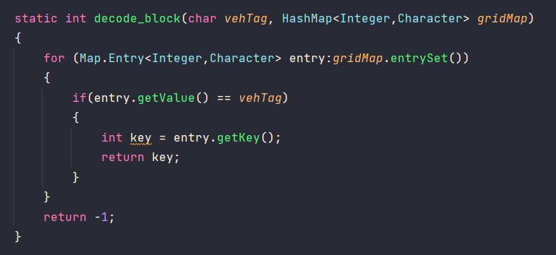
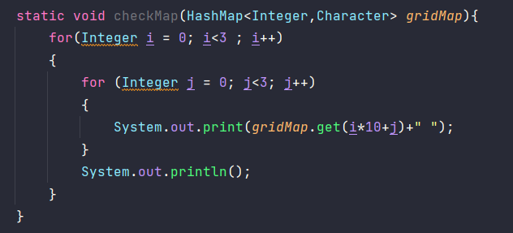
Code Snippets
1. HashMap
Hashmaps are used to store key values pairs that can be updated using put method and recalled using get method.
Hashmaps are extremely useful data structures that allow quick and easy access of stored variables.

Slide 8
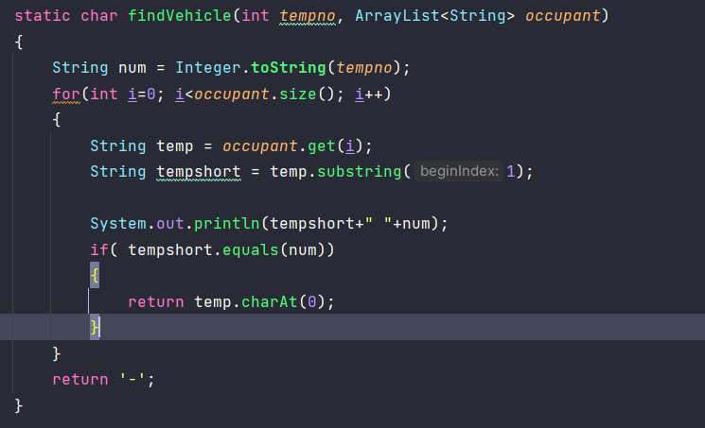
2. Linear Search and String Manipulation
Linear search is the least complex searching algorithm that is superseded by binary search for ordered data.
String manipulation involves making changes to string and performing multiple operations on it such as concatenation and trimming etc.

Slide 9
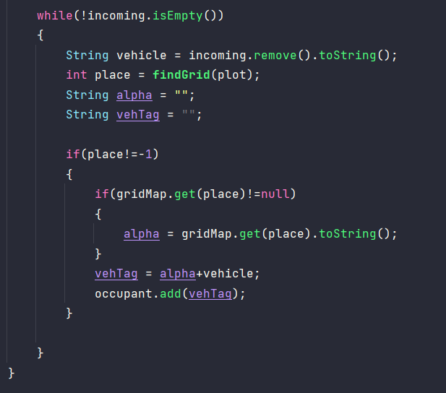
3. Queue
Queue is one of the most important and widely used data structure.
In this project the queue was used to store the queue of cars that lined up to enter the parking lot.
The predefined queue in java provides function like peek,

Slide 10
Scope
The project has much scope to extend to practical use. Nowadays there is human requirement for looking after parking spots. With integration of simple sensors and a proper database such as MySql, the project can be upscaled and implement on a real parking lot.
Other data structures and algorithm can be also implemented, such as recursion can be used to generated unique ids for cars.
President
Chief Executiv Officer
Chief Operatins Officer
VP Marketing

Slide 11

Conclusion
In conclusion it was a great learning experience. Especially the instructors clarity helped me clear earlier doubts and better understand concepts and strengthen earlier learned concept.
The project allowed me to directly play with learnings and explore the concepts on my own

Slide 12
Thank you

